Slide 1


Name of Capstone Project :-
EMPLOYEE RETENTION PREDICTION
STUDENT NAME :- ANKIT AGRAWAL
Batch: DSAI-1 September 2024
CONFIDENTIAL: The information in this document belongs to Boston Institute of Analytics LLC. Any unauthorized sharing of this material is prohibited and subject to legal action under breach of IP and confidentiality clauses.

Slide 2
Agenda
Workflow of Employee Retention Model
Step | Description
1️⃣ Import Required Libraries | Import essential libraries: Pandas, NumPy, Matplotlib, Seaborn, Scikit-learn, XGBoost, LightGBM. Use SMOTE for handling imbalanced data.
2️⃣ Load Data | Read training and testing datasets (aug_train.csv, aug_test.csv). Display initial data using .head().
3️⃣ Data Preprocessing | Handle missing values with SimpleImputer, encode categorical variables using LabelEncoder, and normalize numerical features using StandardScaler.
4️⃣ Exploratory Data Analysis (EDA) | Use Matplotlib & Seaborn for visualizations. Identify feature distributions and correlations with the target variable.
5️⃣ Feature Engineering | Create new meaningful features from existing data to enhance model performance.
6️⃣ Train-Test Split | Split the dataset into training & Test sets using train_test_split() to evaluate model performance.
7️⃣ Handling Imbalanced Data | Apply SMOTE (Synthetic Minority Over-sampling Technique) to balance the dataset and avoid model bias.
8️⃣ Model Training & Evaluation | Train Logistic Regression, Random Forest, XGBoost, LightGBM. Evaluate performance using Accuracy, ROC-AUC, Confusion Matrix. And Classification Report
9️⃣ Hyperparameter Tuning | Optimize model performance using RandomizedSearchCV.
🔟 Model Deployment Considerations | Save the trained model using joblib for deployment in applications like Streamlit.

Slide 3
Introduction – Employee Retention Analysis:-
Overview of Employee Retention Analysis:-
This project aims to develop a machine learning model to predict whether data scientists are likely to seek job changes, aiding in talent retention and recruitment planning.
It should help in optimizing retention strategies, proactive recruitment, and better resource allocation using a predictive model, comprehensive data visualizations, and a comparative analysis of various machine learning algorithms.
Project Benefits:
Retention Optimization: The model will help identify factors influencing job change decisions, allowing for more targeted retention strategies.
Recruitment Planning: Accurate prediction of potential job seekers can assist in proactive recruitment efforts.
Resource Allocation: Understanding job change patterns can guide resource allocation for training and development programs.
Dataset Overview:-
Structure of the Dataset:-
The dataset consists of employee-related information used to predict whether an employee will change their job or not
It includes both numerical and categorical features related to education, experience, training, and company details.
The dataset is divided into training (aug_train.csv) and testing (aug_test.csv) datasets.
Target Variable:-
The target variable is target, which indicates whether an employee is likely to switch jobs (1) or stay in their current job (0).
Problem Type: Binary Classification (0 = No Job Change, 1 = Job Change).

Slide 4
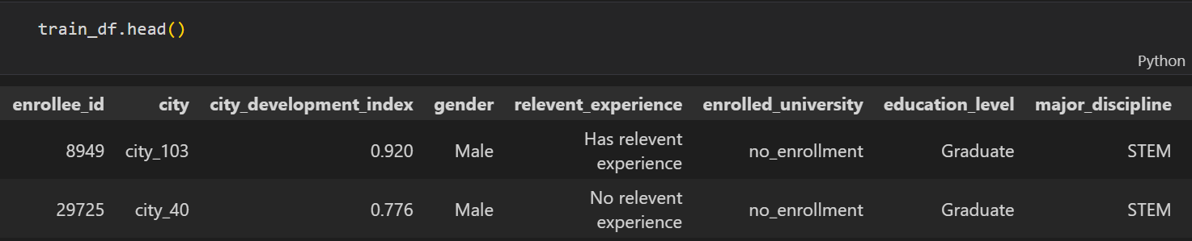
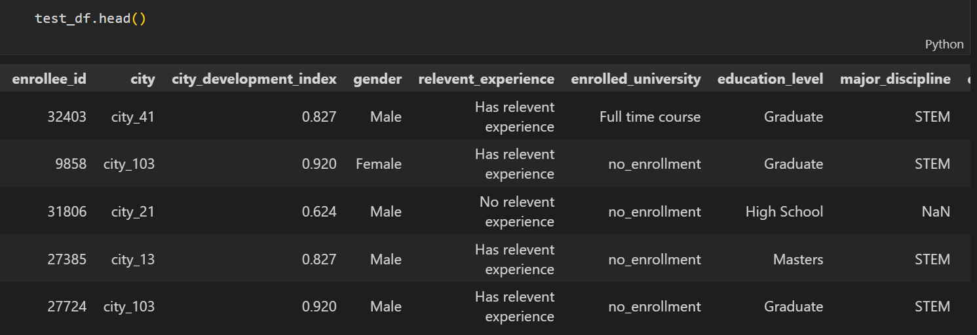
Just Drop two Columns ‘’enrollee_id’’, ‘’city’’ from both Datasets.

Slide 5
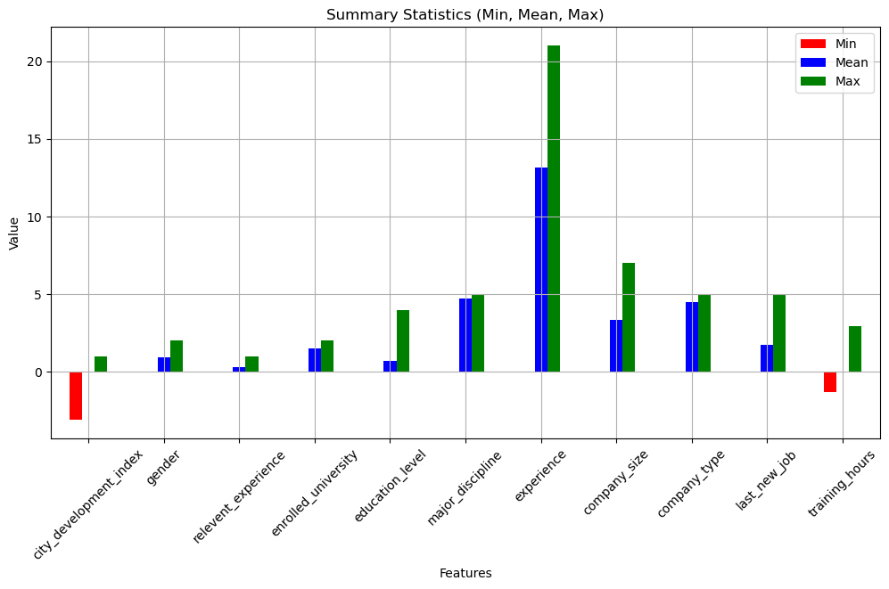
Statistics Summary Visualization using Bar Plot

Slide 6
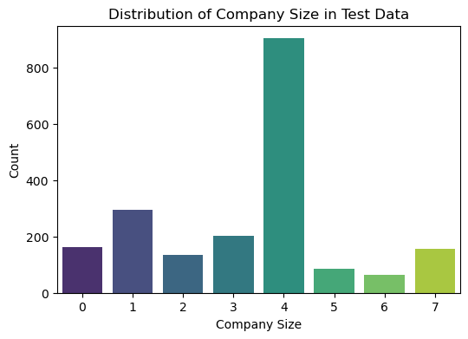
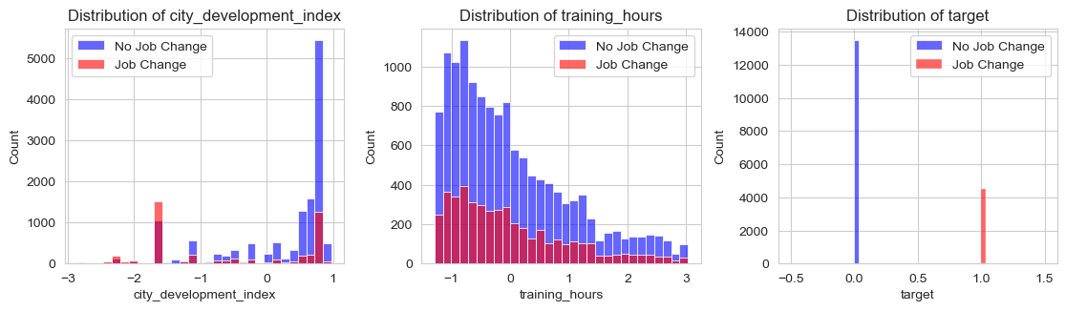
Data Preprocessing:-
Handles missing values using SimpleImputer.
Checking & Removing OUTLIERS using IQR.
Encodes categorical variables using LabelEncoder.
Normalizes numerical features using StandardScaler.
Exploratory Data Analysis (EDA):-
Visualizing the Company Size distribution
Univariate Analysis (Single Feature Distribution)

Slide 7
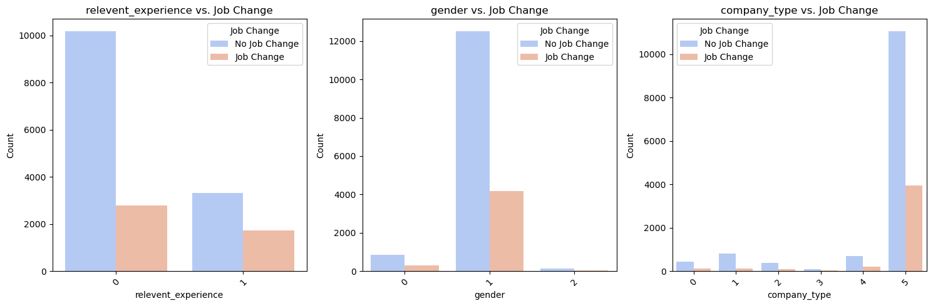
Bivariate Analysis (Relationship Between Two Variables)

Slide 8
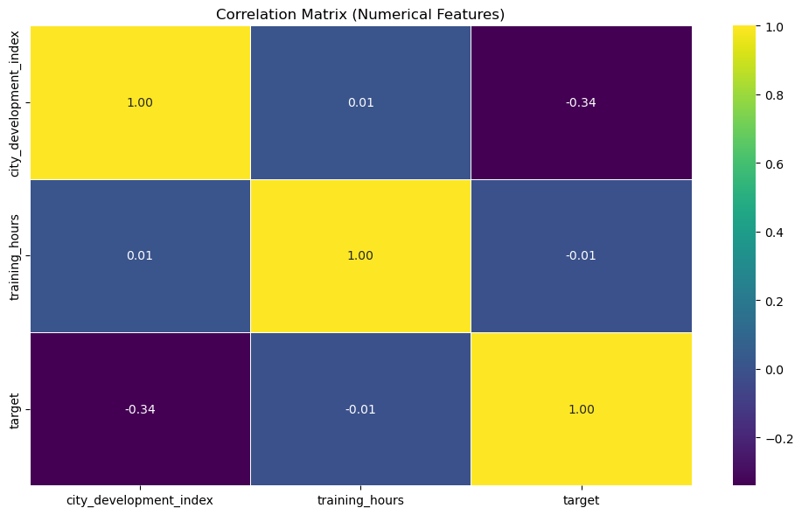
Multivariate Analysis (Multiple Feature Relationships)
Correlation Heatmap

Slide 9
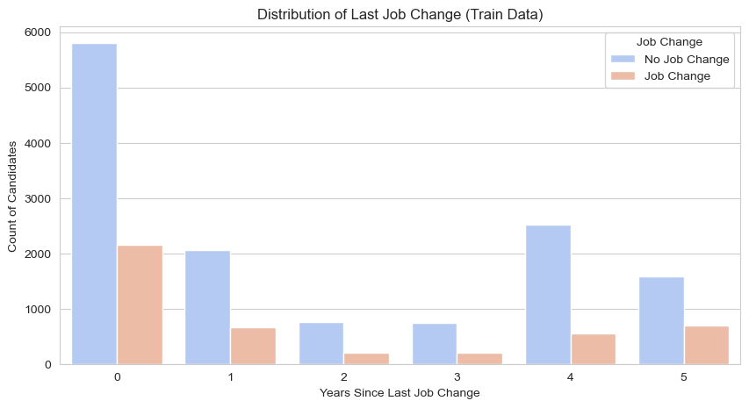
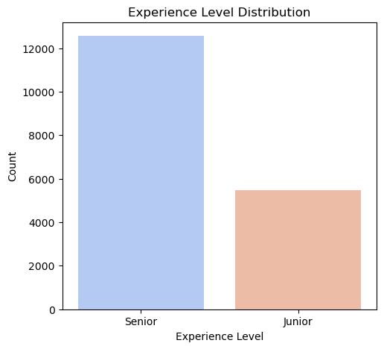
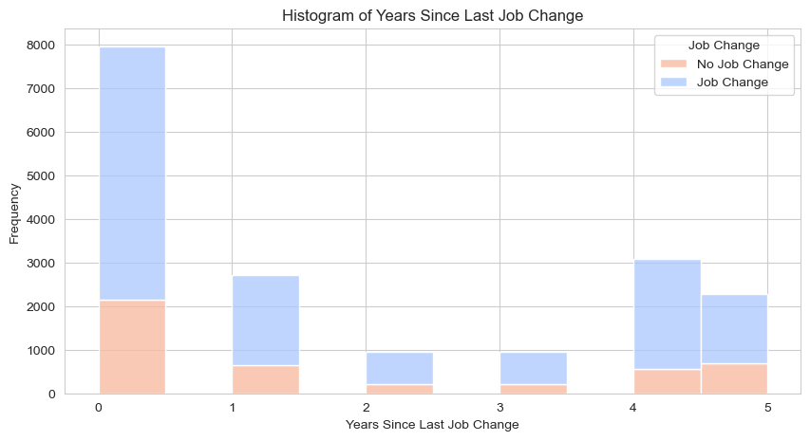
Feature Engineering:-
Creating new features to improve model performance
Experience Bin Distribution Bar plot of 'last_new_job'
Histogram for
years_since_last_job_change

Slide 10
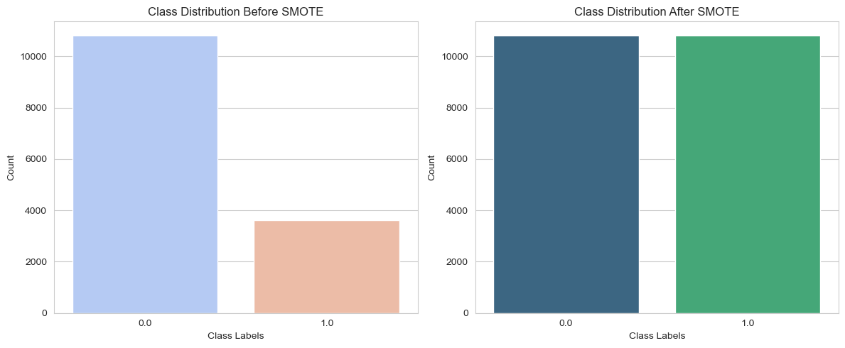
Handling Imbalanced Data :-
Why Do We Need to Balance the Dataset?
When working with employee retention prediction, the dataset is imbalanced, meaning there are more employees staying (0) than leaving (1).
Applying SMOTE (Synthetic Minority Over-sampling Technique)
SMOTE artificially increases the number of minority class samples (employees leaving) by generating synthetic data points.
Before SMOTE: [10811 3621]
After SMOTE: [10811 10811]
Train-Test Split :-
Splits the dataset into training and Test sets using train_test_split().
Model Training & Evaluation :-
Implement Logistic Regression, Random Forest,
XGBoost, and LightGBM.
Uses evaluation metrics like Accuracy, ROC-AUC, Confusion Matrix and Classification Report.

Slide 11
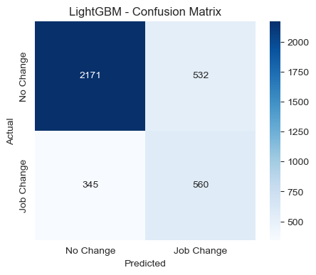
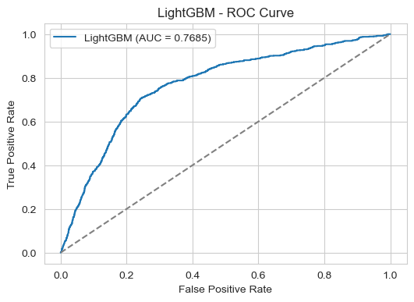
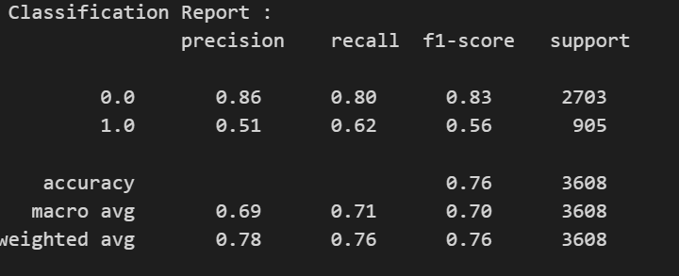
Model Selection Based on Performance
Best Model: LightGBM :-
Highest Accuracy (75. 69 %)
Best ROC-AUC Score (76. 85 %)
Since LightGBM has the highest accuracy and ROC-AUC, it is the best model.
MODEL | ACCURACY | ROC-AUC Score
Logistic Regression | 71.51 % | 73.49 %
Random Forest | 73.75 % | 73.11 %
XGBoost | 74.58 % | 75.38 %
LightGBM | 75.69 % | 76.85 %

Slide 12
Hyperparameter Tuning:-
Why Hyperparameter Tuning?
Optimizes model performance by finding the best combination of hyperparameters. Prevents overfitting.
I used Technique RandomizedSearchCV , it selects random combinations of hyperparameters.
It is More efficient than GridSearchCV for large datasets.
Reduces computational cost while still finding optimal parameters
Explanation of Each Hyperparameter
Best Hyperparameters :-
Hyperparameter | Meaning
n_estimators | The number of boosting iterations (trees). More trees can improve accuracy but increase computation time.
max_depth | The maximum depth of each tree. Controls model complexity and helps prevent overfitting.
learning_rate | Determines how much each tree contributes to the final prediction.
num_leaves | The number of leaves in one tree.
subsample | Fraction of data to be randomly sampled for training each tree. Prevents overfitting.
colsample_bytree | Fraction of features (columns) to be randomly selected for training each tree.

Slide 13
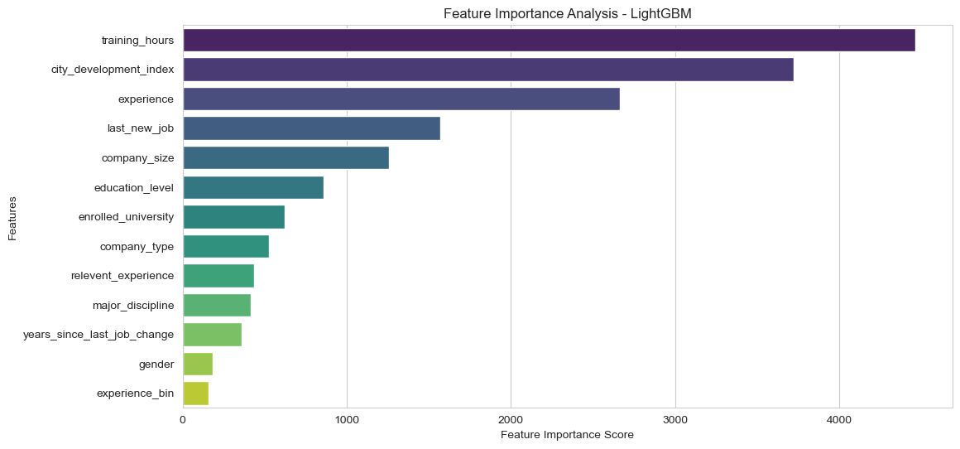
Feature Importance Analysis

Slide 14
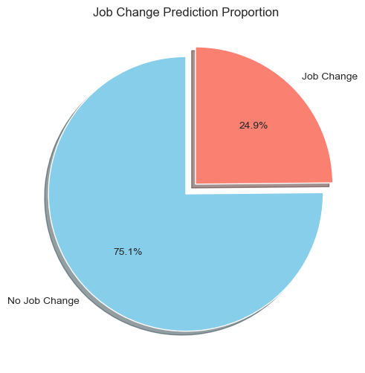
Prediction on Test Data
Load the Trained Model
Use the best-tuned LightGBM model for final predictions.
A Pie-Chart of job change predictions (0 vs. 1).

Slide 15
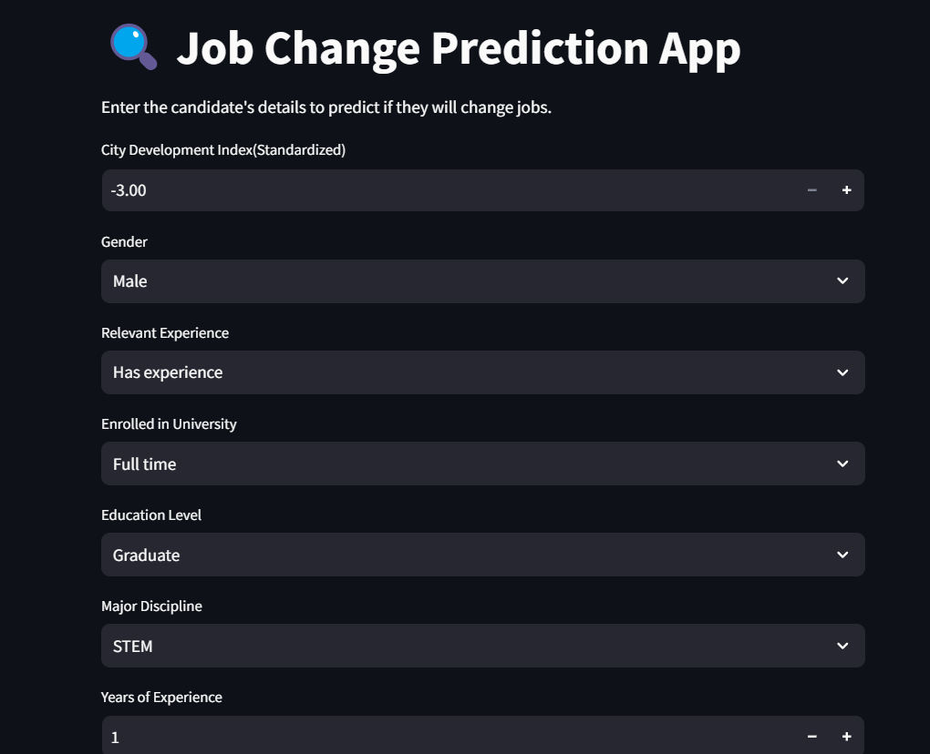
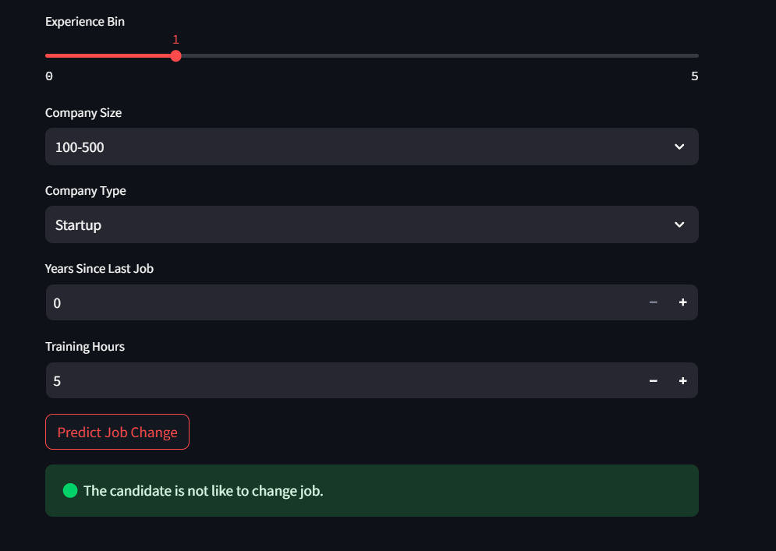
Model Deployment Considerations
Aspect | Description
Why Deployment? | After training and tuning, the model needs to be deployed to make real-world predictions.
Saving the Model | The trained LightGBM model is saved using joblib for easy loading and inference.
Why Use joblib? | - Efficient for large models - Faster than pickle - Reduces loading time in production
How the Model Will Be Used? | - Integrated into a Streamlit web app for user-friendly interaction. - HR teams can input employee details to predict job change likelihood.

Slide 16
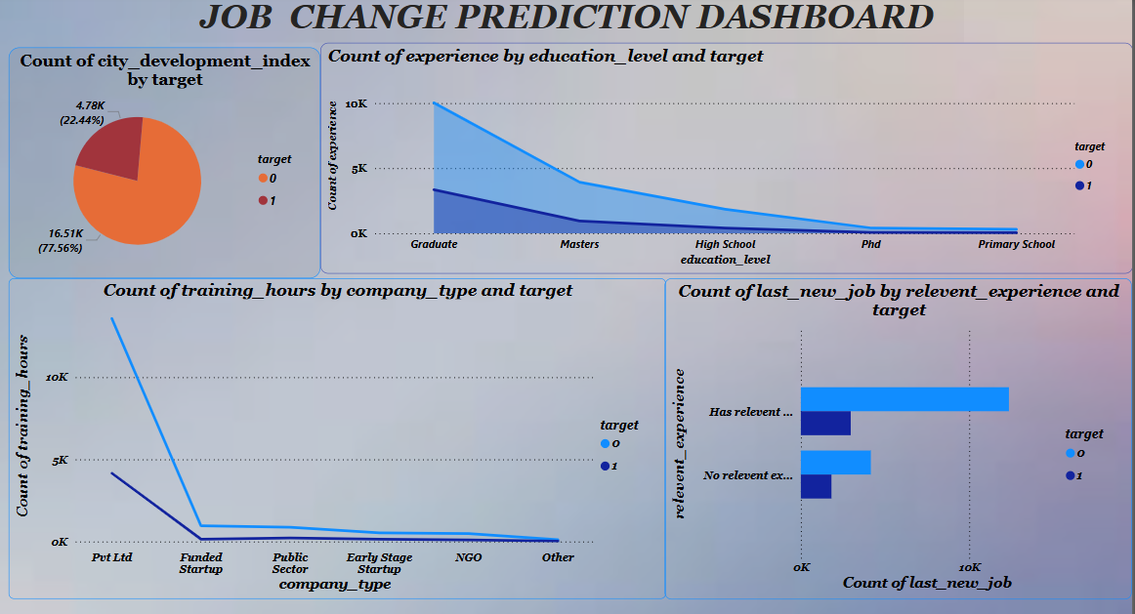
POWER BI DASHBOARD

Slide 17
Thank You!
CONFIDENTIAL: The information in this document belongs to Boston Institute of Analytics LLC. Any unauthorized sharing of this material is prohibited and subject to legal action under breach of IP and confidentiality clauses.

